Slide 1
Interact | Yuan 2017.9
An online system supports real-time chatting service and long-time letter service

Slide 2
What is Interact?
An one-page web application supports:
Real - time chatting service
Long - time letter service
Post letters (share happy moments / ask for advice / share knowledge)
View letters of other users
Hot website quick access service

Slide 3
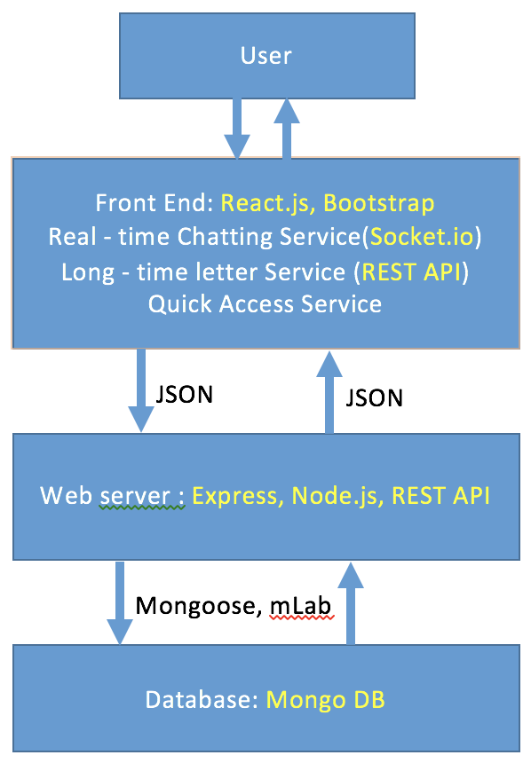
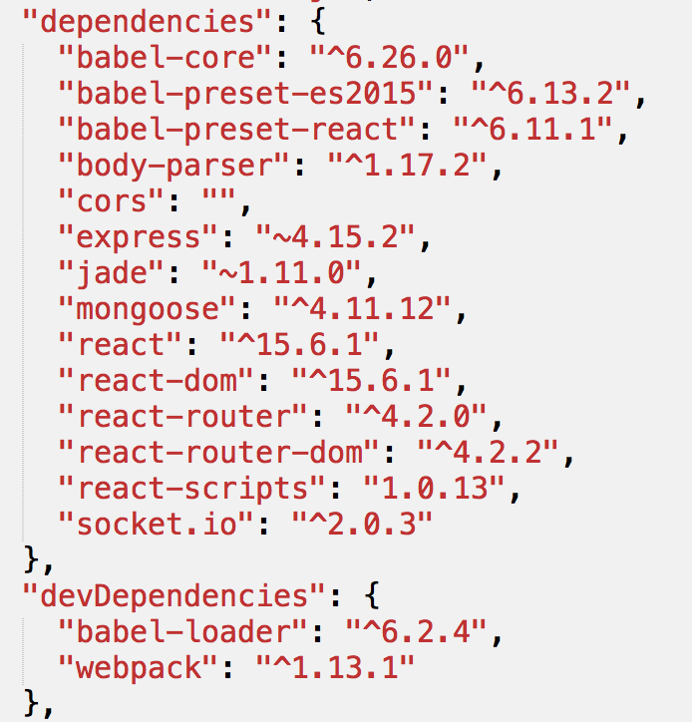
How does your system work?

Slide 4
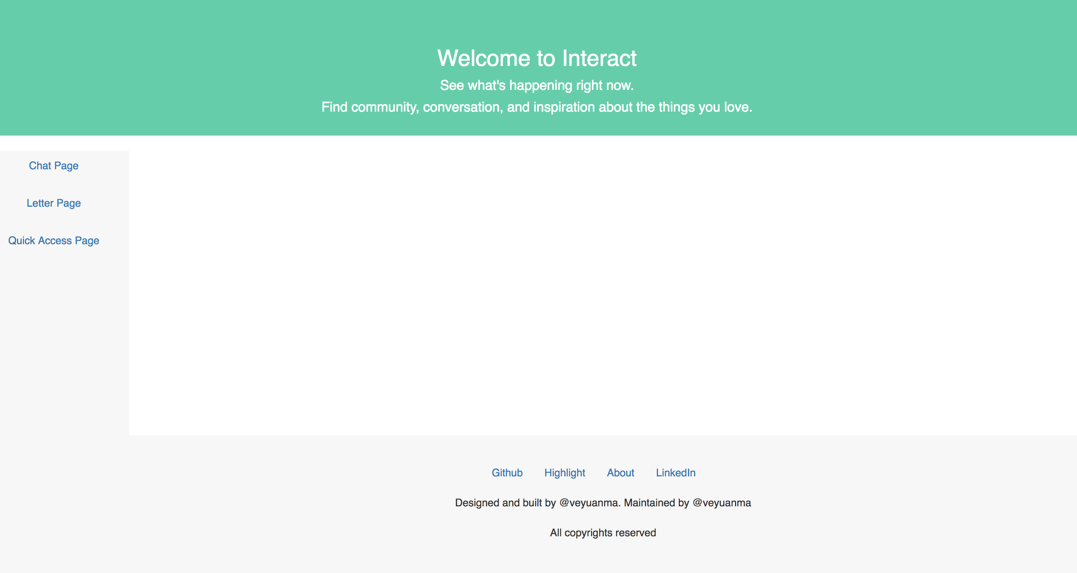
What does your app look like?
header
Chat Component
Letter Component
Quick Access Component
footer

Slide 5
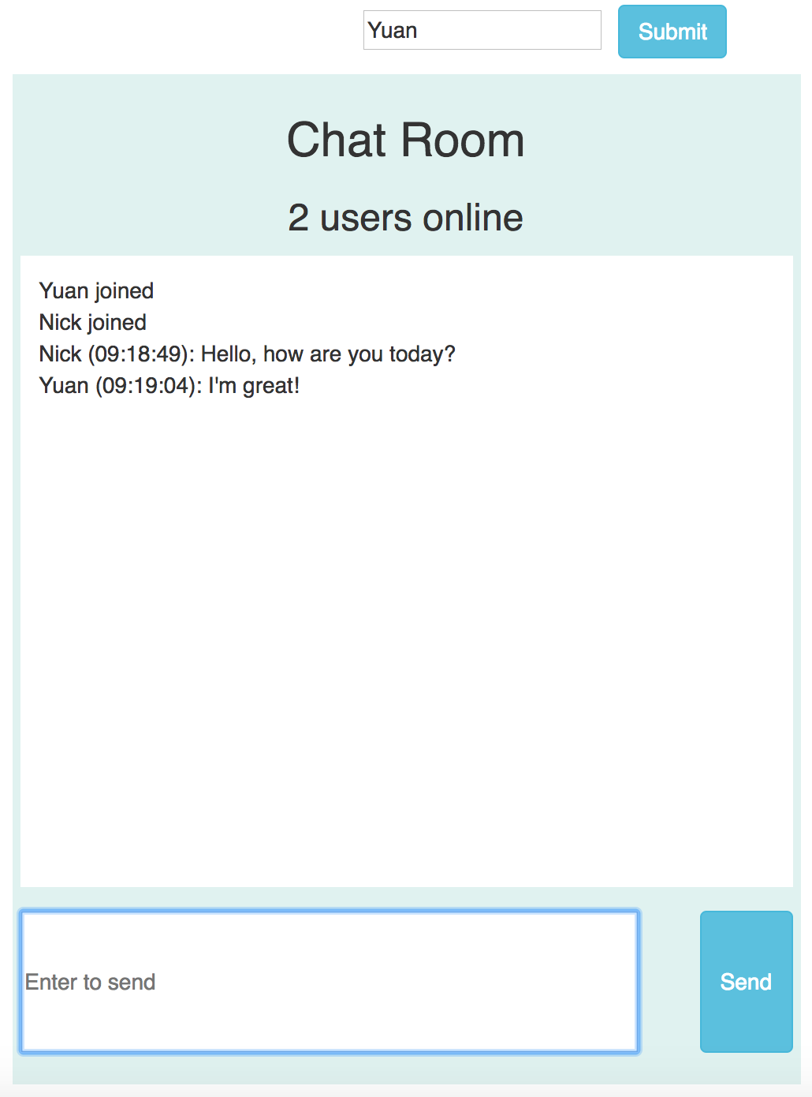
What does chat page look like?
Chat Component
Login Component
Banner Component
Message History Component
Message Component
…
Message Component
Message Input Box Component

Slide 6
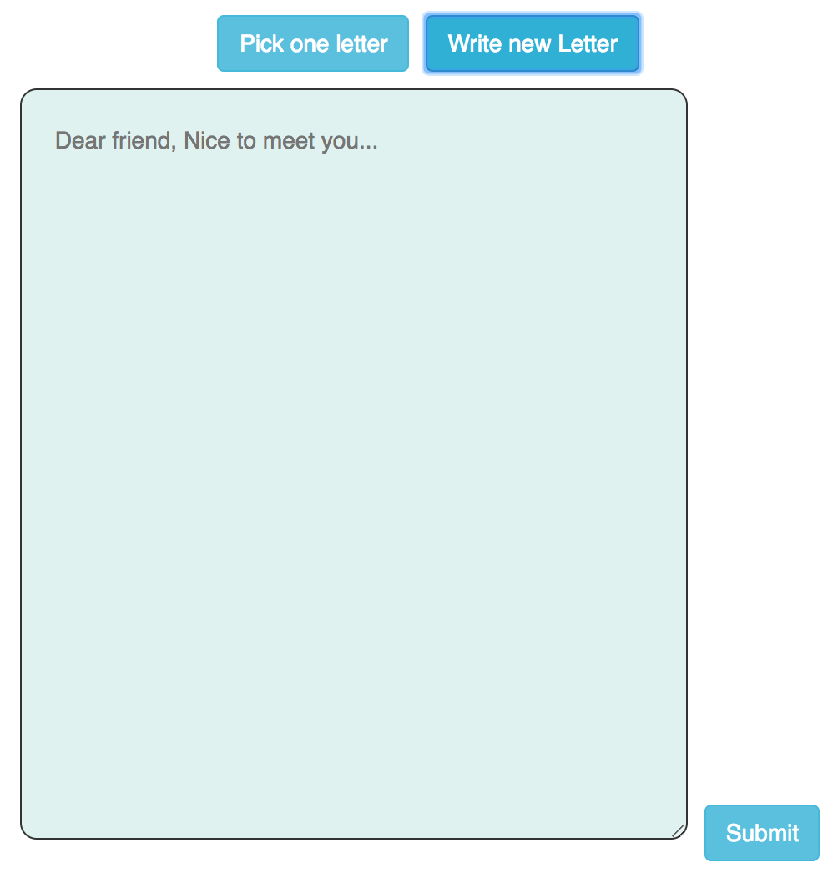
What does letter page look like?
Letter Component
Post Letter Component
Get Letter Component

Slide 7
Show Time

Slide 8
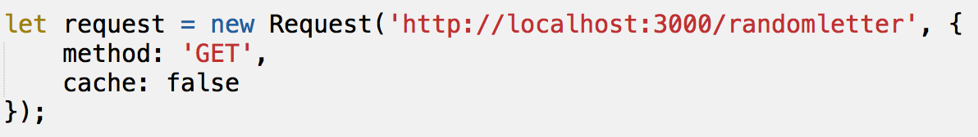
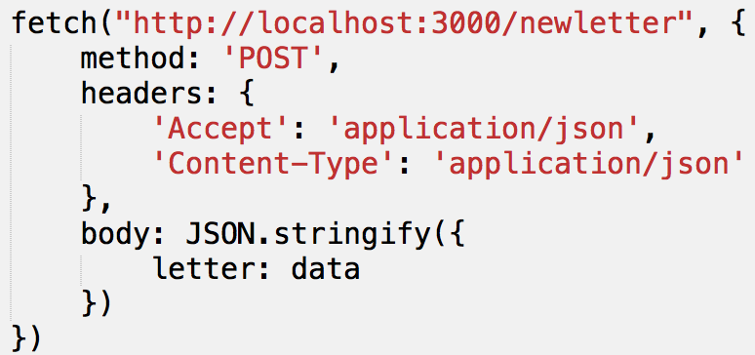
Key techniques in front end
Used React.js to create the view, Bootstrap was applied
Chat Component
Socket.io
Letter Component
REST API : GET / POST

Slide 9
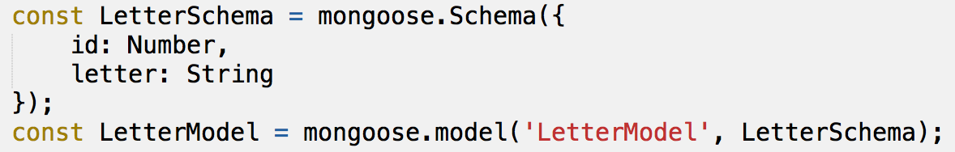
Key techniques in back end
Used Express and Node.js to build the web server
Request Handler
Socket.io
REST API
Database connection
Mongoose and mLab

Slide 10
How would you improve your app?
Add Redis service for message history retrieval
Add more features to chatting page
Load balancing using Nginx

Slide 11
Resources
Github link:
https://github.com/veyuanma/react-project
Contact me:
yuanma666@gmail.com

Slide 12
Thanks

